Slide 1


Deploying Terraform via Azure DevOps with some awesome features
Thomas Thornton & Gregor Suttie

Slide 2
Speaker Intro – Thomas Thornton
10+ years experience in IT
Senior Ops Engineer – Kainos in Belfast
Azure Certified
Azure Solutions Architect
DevOps Engineer
Azure Security Engineer
Azure Administrator
https://thomasthornton.cloud/ - Blogging all things Azure
Twitter:- @tamstar1234

Slide 3
Speaker Intro – Gregor Suttie
23 years' experience in IT​
Developer and DevOps background​
Azure Architect for Intercept in the Netherlands​ ​
Azure MVP and a Microsoft Certified Trainer​ ​
https://gregorsuttie.com/ - Azure Blog​
Twitter:- @gregor_suttie

Slide 4
Agenda
What is Terraform?
Terraform Workflow
Azure DevOps
Deploying Terraform into Azure using Azure DevOps
Demos
Questions?

Slide 5
A way to manage Azure
Easy to read and write
Declarative
Driven via the Azure API
OpenSource Free
Disposable Environments
Lowers the potential for human errors while deploying and managing infrastructure.
What is Terraform?

Slide 6
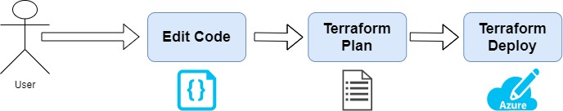
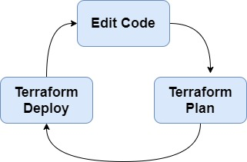
Terraform Workflow
terraform init - Initialize a Terraform working directory
terraform plan - Generate and show an execution plan
terraform apply - Builds or changes infrastructure
terraform output - Read an output from a state file
terraform destroy - Destroy Terraform-managed infrastructure

Slide 7
Terraform Teminology
Providers represent a cloud provider or a local provider
Resources can be invoked to create/update infrastructure locally or on the cloud.
State is representation of the infrastructure created/updated by terraform.
Data Sources are “read-only” resources

Slide 8

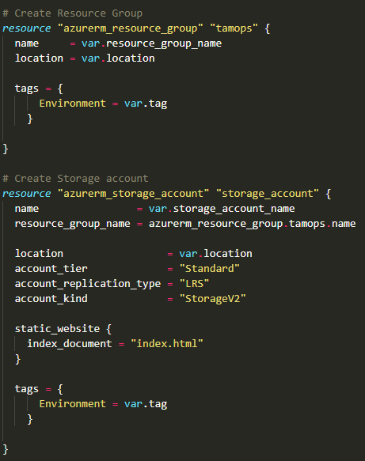
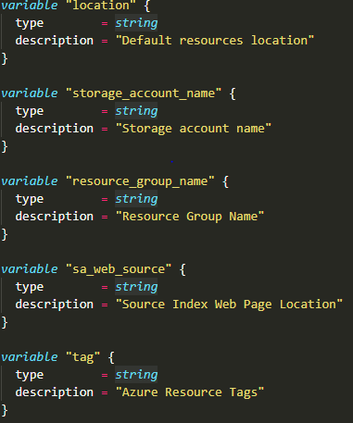
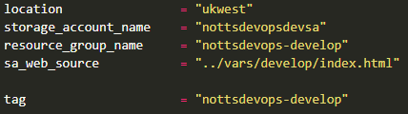
Terraform templates
variables.tf
main.tf
develop.tfvars

Slide 9
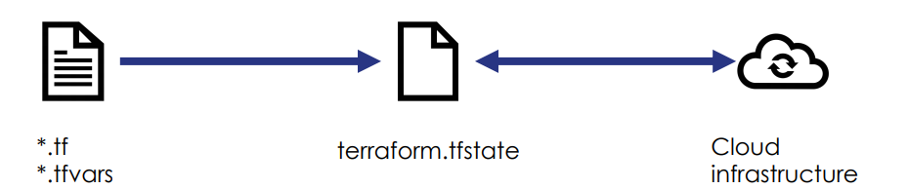
Terraform State
Terraform must store state about your managed infrastructure and configuration.
This state is used by Terraform to map real world resources to your configuration, keep track of metadata, and to improve performance for large infrastructures.
This state is stored by default in a local file named "terraform.tfstate", but it can also be stored remotely, which works better in a team environment.

Slide 10
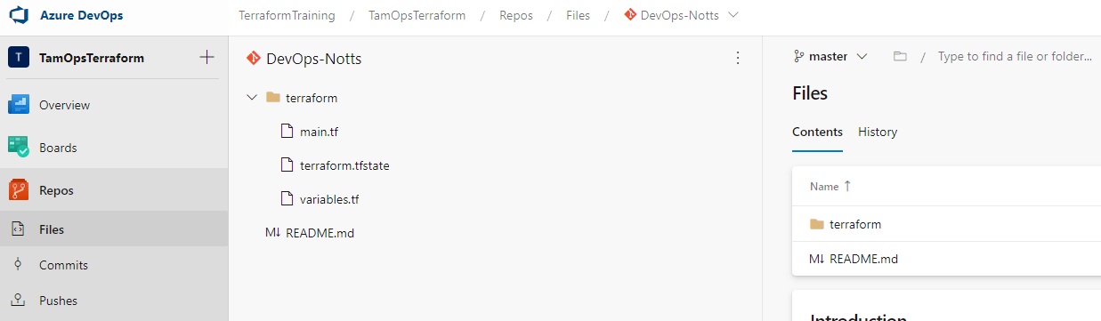
Azure Repos
Part of Azure DevOps
A Git repository that will be used to store your Terraform code
Deploying your Pipeline will reference an Azure Repo
Plan smarter, collaborate better and ship faster with Azure DevOps Services © Azure DevOps

Slide 11
Azure Pipelines is a cloud service that you can use to automatically build and test your code project and make it available to other users. It works with just about any language or project type.
Azure Pipelines combines continuous integration (CI) and continuous delivery (CD) to constantly and consistently test and build your code and ship it to any target.
Within our environment, we will be using Azure Pipelines to deploy our Terraform code
You define pipelines using the YAML syntax or through the Azure DevOps portal – we will be using YAML
Azure Pipelines

Slide 12

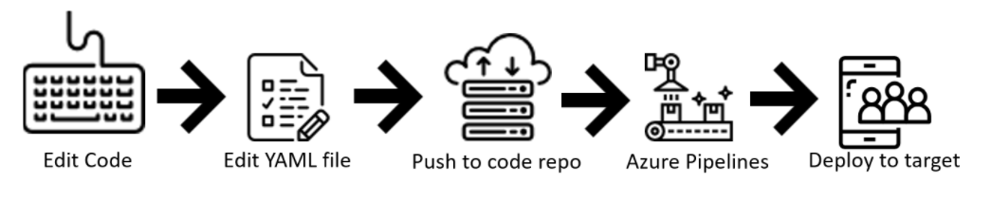
Azure Pipelines via Code
You define your pipeline in a YAML file within your repo, azure-pipelines.yml for example
The YAML pipeline is versioned the same way as your Terraform code.
It will follow the same branching structure allowing you to have a pull-request process for any changes to any Pipelines that you may make
Will look at some cool pipeline/repo additions

Slide 13

Azure Pipelines:- Additional Info
We’ve covered the basics of Azure Pipelines and how they are created using YAML. Some more info on additional components that will be used within Azure Pipelines
How do the Pipelines run?
Can be manual within Azure DevOps Portal or create a trigger to tell a pipeline to run.
Variable Groups
Used to store values that you want to control and make available across multiple pipelines.
Approval Gates
Can be used for Pre-Deployment and Post-deployment conditions within a Pipeline. For example, when terraform plan is successful; before terraform apply is ran you can create an Approval gate to allow review of the Terraform plan etc.
Trigger
A trigger is something that's set up to tell the pipeline when to run.

Slide 14

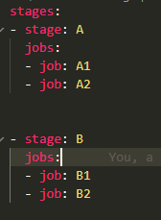
1. Single Step
Azure Pipelines Breakdown
You can organise your pipeline into jobs.
Every pipeline has at least one job.
A job is a series of steps that run sequentially as a unit
Your pipeline may have multiple stages, each with multiple jobs. In that case, use the stages keyword.
2. Multi-stage

Slide 15
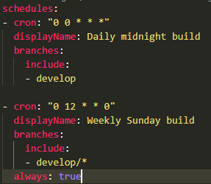
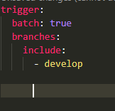
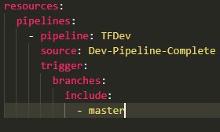
Azure Pipelines Breakdown:- Triggers
2. Schedule Triggers
1. PR Trigger
Use triggers to run a pipeline automatically.
Azure Pipelines supports many types of triggers.
Common Triggers
PR Triggers
Scheduled Triggers
Pipeline Trigger
3. Pipeline Trigger

Slide 16
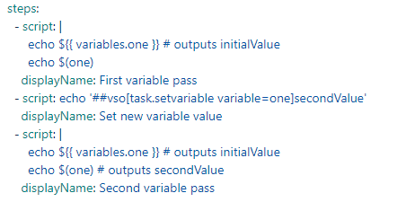
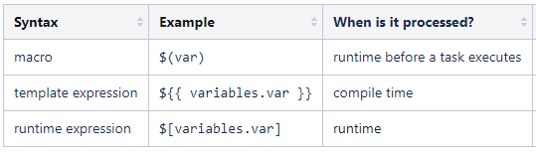
Azure Pipelines Breakdown:- Variables
Variables give you a convenient way to get key bits of data into various parts of the pipeline.
Azure Pipelines supports three different ways to reference variables: macro, template expression, and runtime expression. Each syntax can be used for a different purpose and has some limitations.
Example of macro, template and runtime variables

Slide 17

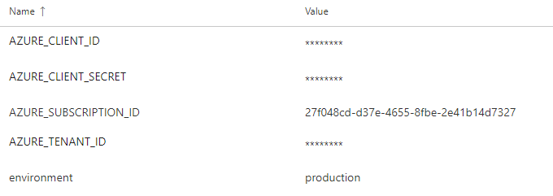

Azure Pipelines Breakdown:- Variable Groups
YAML Variable Group
Variable groups are great; used throughout our Pipelines
Use a variable group to store values that you want to control and make available across multiple pipelines
You can also use variable groups to store secrets and other values that might need to be passed into a YAML pipeline.
Variable Group variables
Reference variable in pipeline

Slide 18
Demo Time
What will be covered?
Azure Pipeline deployment with Terraform
Multi-branch triggers
I don’t want to validate my code in the main pipeline, what can I do?
Can I test what I have deployed? Ofcourse, we will touch briefly on Inspec-Azure!

Slide 19

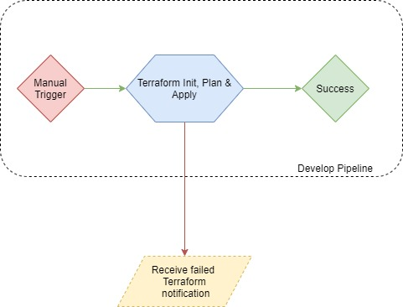
Where did we start?

Slide 20
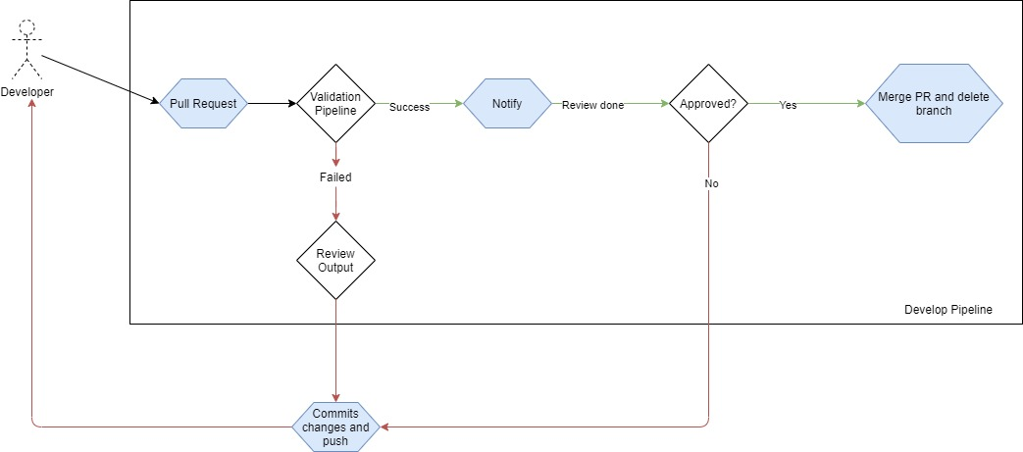
We added a build validation pipeline!
Keeps the main pipeline clean!
Can validate Terraform code before it reaches an environment pipeline
Can review the plan during PR

Slide 21
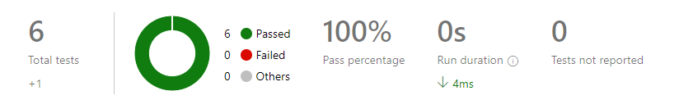
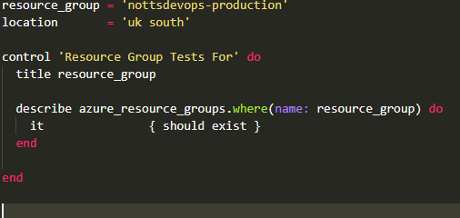
Testing what you deployed
Inspec-Azure is a resource pack provided by Chef that uses the Azure REST API, to allow you to write tests for resources that you have deployed in Microsoft Azure.
These tests can be used to validate the Azures resources that were deployed via code using Terraform or even Azure RM templates
Inspec is an open source framework that is used for testing and auditing your infrastructure

Slide 22
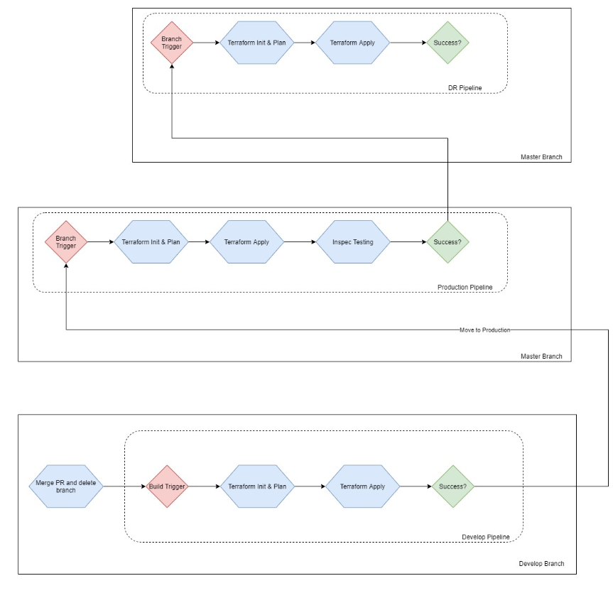
The finish:- Multibranch pipeline!
From one environment to another
Pipeline triggers are great
Test that infrastructure!

Slide 23
Key Takeaways
Terraform is readable and quite user friendly
The beginning of CI/CD deployments
Use of triggers for automation
Test outside of your pipeline
Inspec is a fun additional, worth checking out further
The urge to see even more of Azure DevOps & what it can do! :D

Slide 24
Recommended blog posts
Deploy Terraform using Azure DevOps https://thomasthornton.cloud/2020/07/08/deploy-terraform-using-azure-devops/
1
Validating Terraform Code During a Pull request in Azure DevOps https://thomasthornton.cloud/2020/07/29/validating-terraform-code-during-a-pull-request-in-azure-devops/
2
Deploying Terraform from Develop to Production consecutively using Azure DevOps https://thomasthornton.cloud/2020/09/22/deploying-terraform-from-develop-to-production-consecutively-using-azure-devops/
3
Inspec-Azure in Azure DevOps Pipeline https://thomasthornton.cloud/2020/08/27/inspec-azure-in-azure-devops-pipeline/
4
Azure DevOps – 6 Recommendations to help with securing your branches https://thomasthornton.cloud/2020/09/03/azure-devops-6-recommendations-to-help-with-securing-your-branches/
5
GitHub for demo/slides https://github.com/thomast1906/talks-and-demos/tree/main/Azure-Notts-DevOps
6

Slide 25
Azure Blog’s
YouTube
User Groups & Virtual Conferences
GitHub Resources
CloudFamily.info #cloudfamily
Community #azurefamily
Community Resources

Slide 26
Questions
Twitter: @tamstar1234 https://twitter.com/tamstar1234
LinkedIn: https://bit.ly/34b2kvi
Blog: https://thomasthornton.cloud/

